Slide 1
RNN for gene prediction

Slide 2
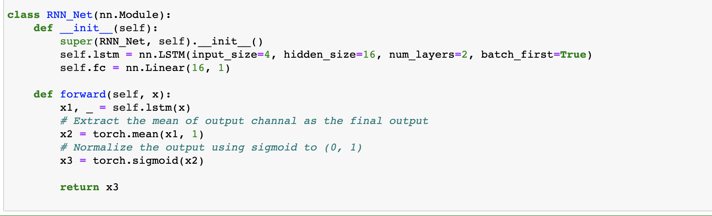
RNN implementation

Slide 3
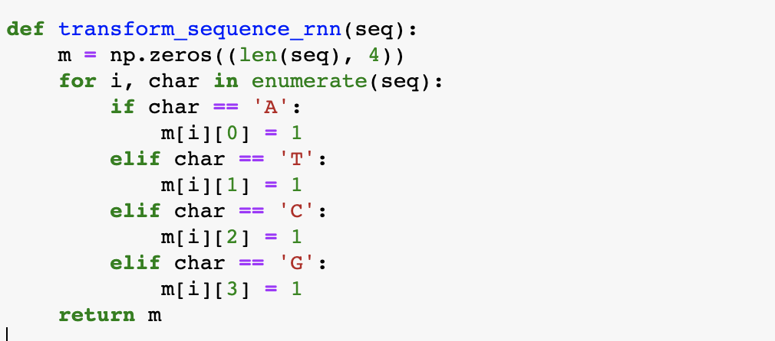
One hot embedding for gene sequence

Slide 4
Training process

Slide 5
Error analysis
RMSE: 0.08311395
Relative RMSE: 0.17343473

Slide 6
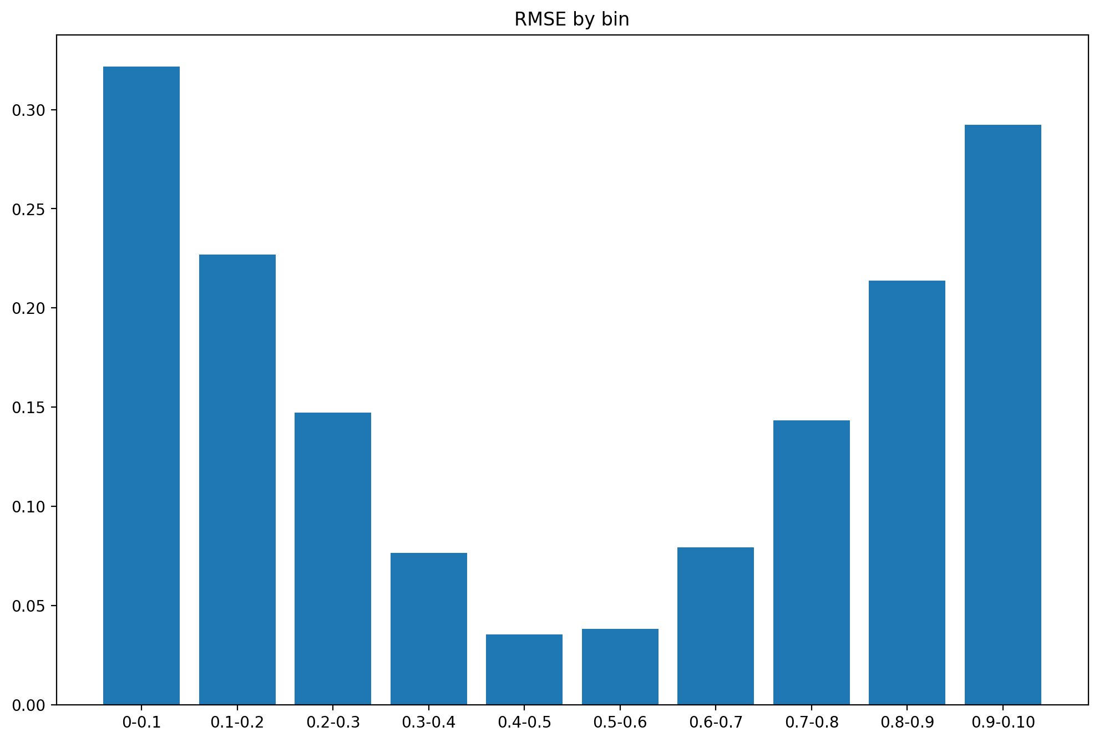
Error analysis

